Slide 1

SYMBIOSIS SKILLS AND PROFESSIONAL UNIVERSITY
Fake News Detection using NLP Machine Learning
Guided By
Ms. Shilpa Honnannavar (Trainer ML-15)
Presented By
Mr. Omkar A. Waghmare
Mr. Ajay M. Sangewar

Slide 2


Introduction to Fake News
Fake news refers to deliberate misinformation presented as news. It is designed to mislead readers and can have serious consequences. With the rise of social media, the spread of fake news has become a significant issue, impacting public opinion and even elections.

Slide 3

Importance of Detecting Fake News
1
Preservation of Truth
2
Impact on Society
Detecting fake news is crucial for preserving the truth and maintaining the integrity of news sources.
Fake news can mislead and manipulate the public, impacting their beliefs and decisions.
3
Trust in Media
Identifying and combatting fake news is essential for restoring and maintaining trust in the media.

Slide 4
Overview of NLP (Natural Language Processing)
Text Analysis
Language Understanding
NLP involves analyzing and understanding human language, enabling machines to derive meaning from text.
NLP allows machines to understand, interpret, and respond to human language in a valuable and meaningful way.

Slide 5
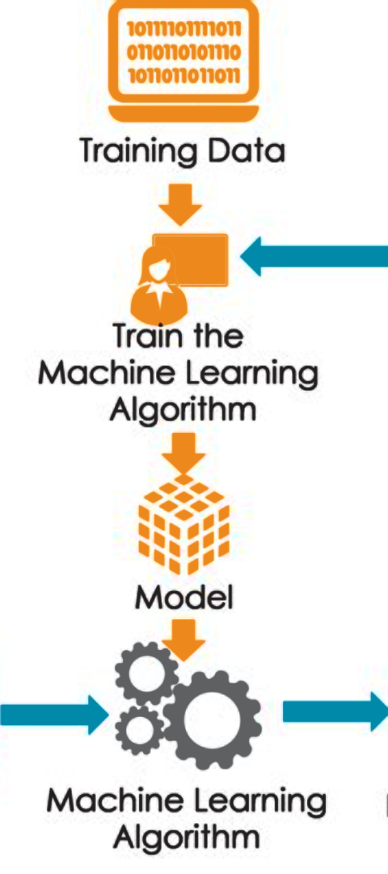
Role of Machine Learning in Fake News Detection
Data Analysis
Pattern Recognition
Machine learning algorithms play a vital role in analyzing large amounts of data to identify patterns and trends associated with fake news.
They utilize pattern recognition to distinguish between genuine and fake news based on various features and characteristics.

Slide 6



Libraries & Tools Used In The Project
Scikit-learn
Leveraged for implementing machine learning algorithms, including the Passive Aggressive classifier, and providing tools for data preprocessing and model evaluation.
TF-IDF Vectorizer
Applied for feature extraction,
calculating the importance of words in the corpus and
transforming the text data into numerical vectors suitable for machine learning algorithms.
Joblib
especially useful for machine learning models because it allows you to save the state of your computation and resume your work later or on a different machine. Understanding the importance of the Joblib library and why saving our machine learning models is useful.

Slide 7
Classification Algorithms for Fake News Detection
Naive Bayes
Decision Trees
Random Forest
Support Vector Machines
Logistic Regression
K-Nearest Neighbors

Slide 8
Evaluation Metrics for Assessing Fake News Detection Models
Accuracy
Precision
Recall
Accuracy
Precision
Recall
The proportion of true results (both true positives and true negatives) among the total number of cases examined.
The fraction of relevant instances among the retrieved instances, providing insight into the usefulness of the model's predictions.
The fraction of relevant instances that have been retrieved over the total amount of relevant instances, indicating the model's ability to find all relevant cases within a dataset.

Slide 9
Data Source
•https://data-flair.training/blogs/advanced-python-project-detecting-fake-news/
•https://chat.openai.com/

Slide 10

Conclusion and Future Directions
1
Current State
Reflect on the advancements made in detecting and combating fake news through NLP and machine learning.
2
Future Innovations
Explore potential advancements in technology and methodologies to enhance fake news detection and minimize its impact.

